Slide 1
Cool Microcontroller Projects ICOM/PC Interface Controller
Dave VE3OOI
Feb 2021

Slide 2
BACKGROUND
Needed a solution to use Digital modes from PC
Long history interfacing PC to ICOM IC-707
Plagued with RFI and ground loops.
Fried Transistors.
Needed a better solution with isolated grounds and optocouplers

Slide 3
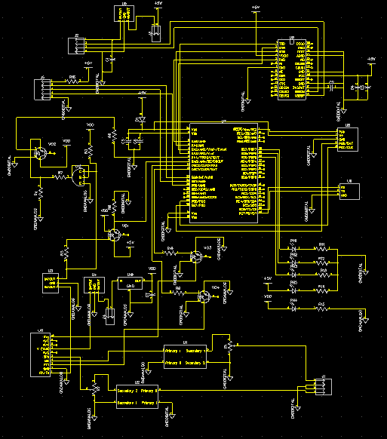
CIRCUIT
USB Power Supply Choke
USB Interface Chip
Two separate grounds that NEVER touch
PIC 16F777
Radio Power Supply Choke
Optoisolators
Audio Transformers

Slide 4
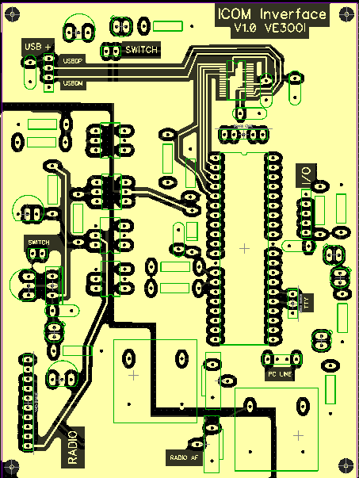
PCB
USB PS Switch
USB Interface
ISCP Interface
Future Interface
RF PS Switch
TTY Interface
Radio Interface
PC Sound Card Interface
Sound Level POTs

Slide 5
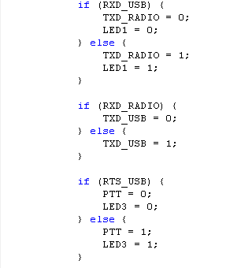
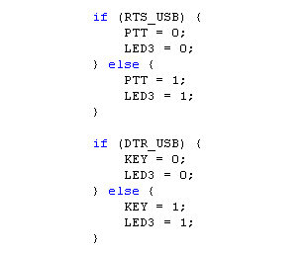
SOFTWARE
Check USB PIN set Radio PIN (invert if necessary)
Check Radio PIN and set USB pin (invert if necessary)
ISD 1760

Slide 6
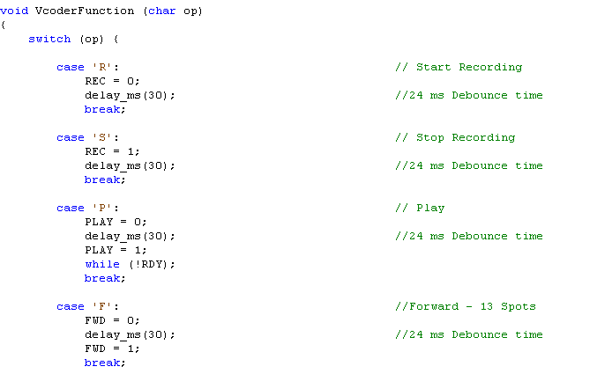
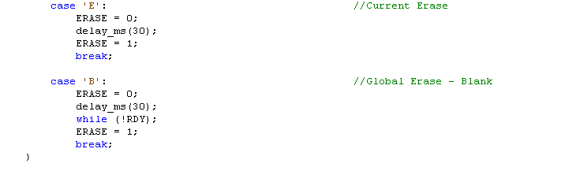
ISD1750
REC, PLAY, FWD, ERASE are all PIC uController PINs that act like a push button
PIC16F777
During playback, “block” until playback is finished
RDY is a signal from ISD1760 for function complete
ISD 1760
During erase, “block” until erase is finished

Slide 7
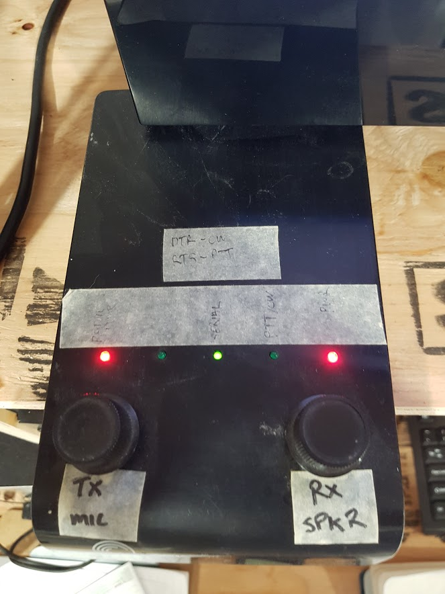
BUILD

Slide 8
FIN

